Slide 1


Data Structure
Dr Shahjad
Faculty
School of Engineering & Technology
K.R. Mangalam University
Unit 4 : Sorting and Searching

Slide 2


Learning outcomes
Linear Search
How to search an Element
Example of Linear Search
Algorithm of Linear Search and Its
Applications
Complexity Analysis of the Linear Search
Brainstorming Session

Slide 3
RECAP
Quicksort is a sorting algorithm based on the Divide and Conquer algorithm that picks an element as a pivot to perform sorting.
How to Choose the Pivot
Always pick first element as pivot
Always pick last element as pivot
Pick a random element as pivot
Pick median as pivot.

Slide 4

Objective of the Session
Gain the intuition for searching
Understand the need for searching
Learn the naive way to search a random number list, namely Linear Search
Understand the Time Complexity of Linear Search

Slide 5
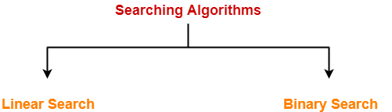
Searching
Searching is a process of finding a particular record, which can be a single element or a small chunk, within a huge amount of data.
The data can be in various forms: arrays, linked lists, trees, heaps, and graphs etc. With the increasing amount of data nowadays, there are
multiple techniques to perform the searching operation.

Slide 6
Linear Search
Linear search is also called as sequential search algorithm. It is the simplest searching algorithm.
In Linear search, we simply traverse the list completely and match each element of the list with the item whose location is to be found.
If the match is found, then the location of the item is returned; otherwise, the algorithm returns NULL.

Slide 7

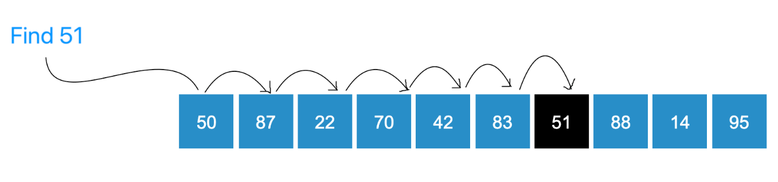
How can we search an element in an array?
In linear search, we adopt the most naive method for searching.
We look through the array in an orderly fashion, comparing each element with the element we would like to find, namely the query element.
Whenever we find a matching element, we report the index of the matched element If we have traversed the entire array and not found a matching element, we report that the element is not present in the array.

Slide 8
Important Observations
Let's take note of a few important observations :
We do not require any ordering of the elements of the array to find a particular element in the array.
This is because we iterate through the entire array for searching the element, so we are guaranteed to find the element if it present in the array.
If the element is not present in the array we are guaranteed that the
algorithm returns failure.
Unit2

Slide 9
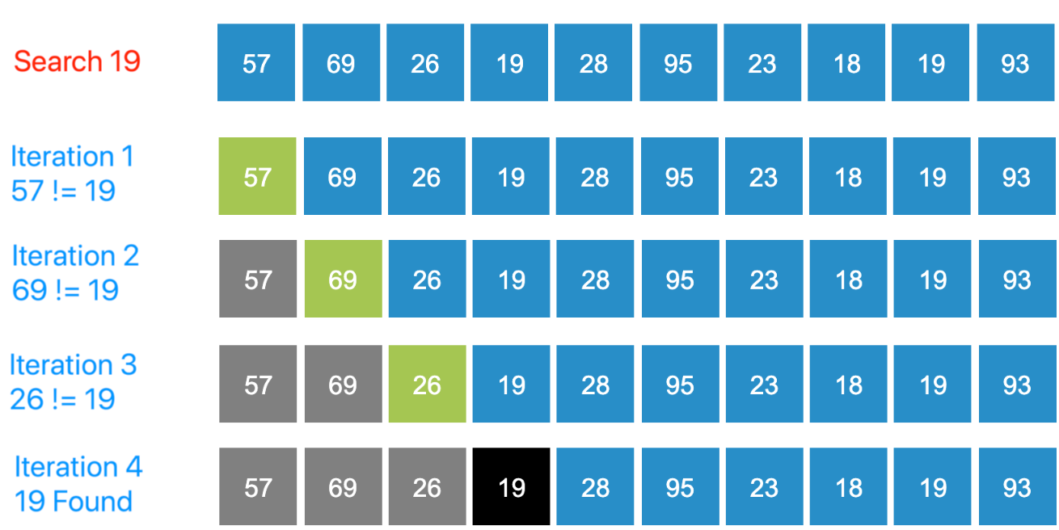
Step by Step Process for Searching an Element

Slide 10
Algorithm
Linear_Search(a, n, val) // 'a' is the given array, 'n' is the size of given array, 'val' is the value to search
Step 1: set pos = -1
Step 2: set i = 1
Step 3: repeat step 4 while i <= n Step 4: if a[i] == val
set pos = i print pos go to step 6 [end of if] set ii = i + 1
[end of loop]
Step 5: if pos = -1
print "value is not present in the array " [end of if]
Step 6: exit

Slide 11
Algorithm
Let's have a final look at the consolidated algorithm to search for an element in an array of N elements:
STEP 1 : Start from the leftmost element of list and one by one compare the query element with each element of the list.
STEP 2 : If the query element matches with an element, return the index.
STEP 3 : If the query element doesn’t match with any of elements, return failure.

Slide 12
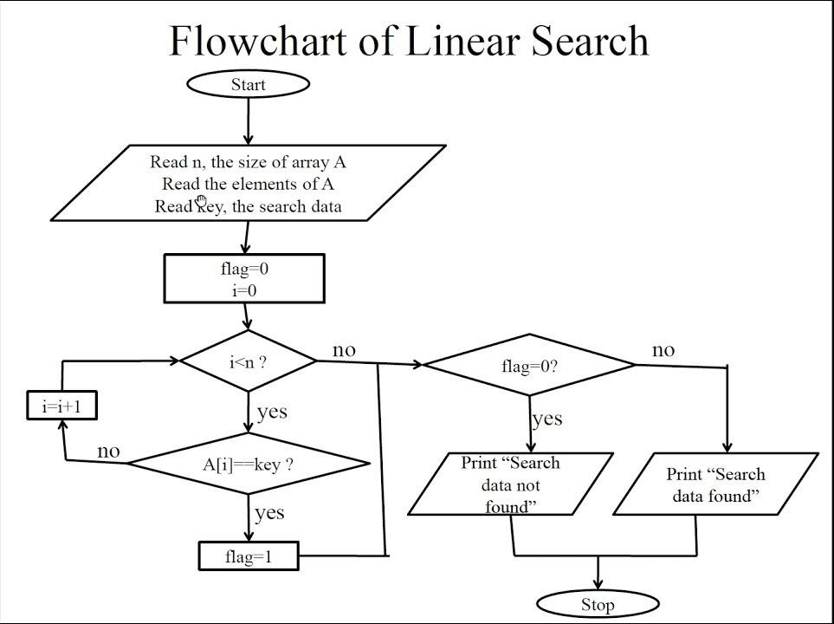

Slide 13

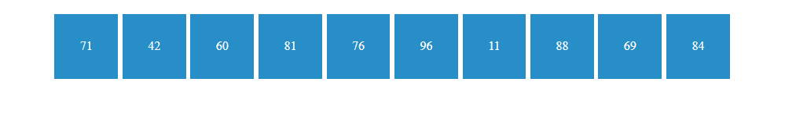



Demo

Slide 14
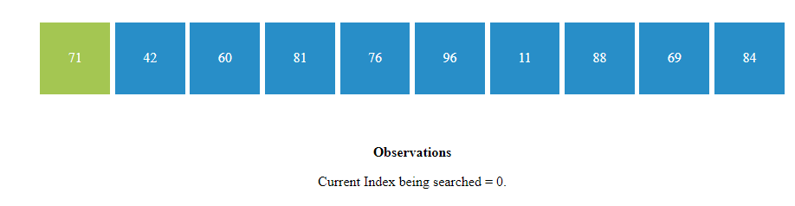
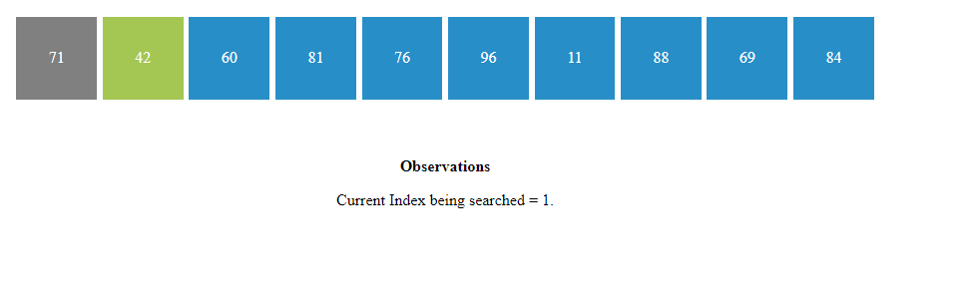
Demo

Slide 15
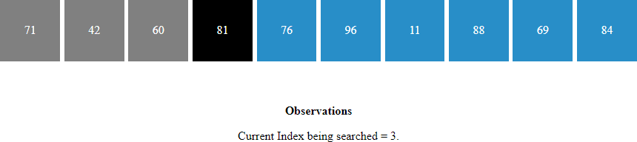
Demo
Unit2

Slide 16
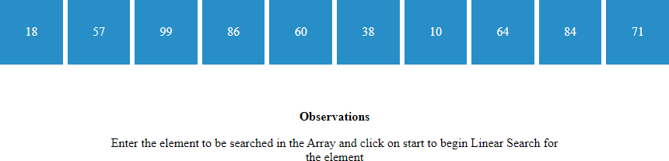
Demo

Slide 17

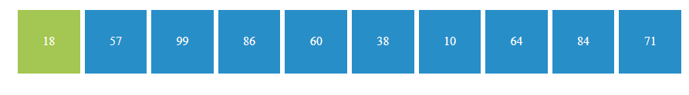
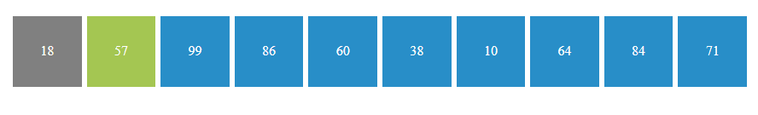
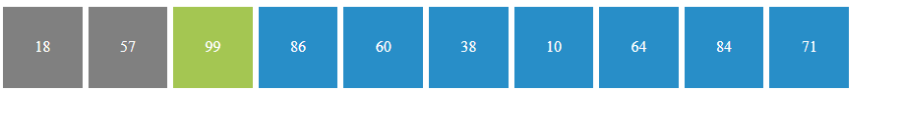
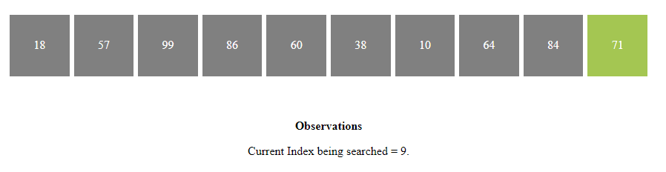
Demo

Slide 18

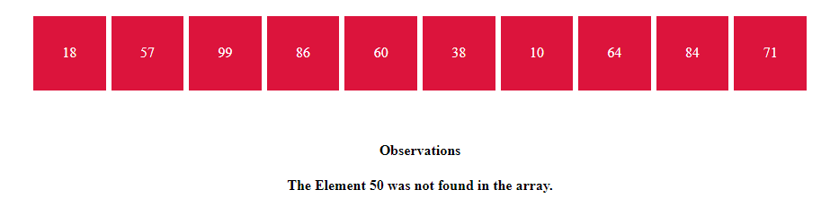
Demo

Slide 19
code
int search(int arr[],
int n, int x)
{
int i;
for (i = 0; i < n; i++)
if (arr[i] == x)
return i;
return -1;
}
Complete code here

Slide 20
Linear Search complexity
Case | Time Complexity
Best Case | O(1)
Average Case | O(n)
Worst Case | O(n)
The space complexity of linear search is O(1).

Slide 21
Applications of Linear Search
Unsorted Lists: When we have an unsorted array or list, linear search is most commonly used to find any element in the collection.
Small Data Sets: Linear Search is preferred over binary search when we have small data sets with
Searching Linked Lists: In linked list implementations, linear search is commonly used to find elements within the list. Each node is checked sequentially until the desired element is found.
Simple Implementation: Linear Search is much easier to understand and implement as compared to Binary Search or Ternary Search.

Slide 22
Advantages of Linear Search
Linear search can be used irrespective of whether the array is
sorted or not. It can be used on arrays of any data type.
Does not require any additional memory.
It is a well-suited algorithm for small datasets.

Slide 23
Disadvantages of Linear Search
Linear search has a time complexity of O(N), which in turn makes it slow for large datasets.
Not suitable for large arrays.
When to use Linear Search
When we are dealing with a small dataset.
When you are searching for a dataset stored in contiguous memory.

Slide 24
Test Your Knowledge
How do you describe an array?
a: Data structure having linear access time
b: Data structure containing elements of similar types in contiguous storage c: A container of unique elements of similar types
d: Data structure containing elements located in various locations memory which may or may not be contiguous
What is the time complexity of traversing through all the elements in an array?
a: O(N^2)
b: O(1)
c: O(N)
d: O(log N)

Slide 25
Test Your Knowledge
3. Let us consider the following code:int a = 0, b[N];
for (i = 0; i < M; i++) {
a+=i;
}
for (i = 0; i < N; i++) { scanf(\“%d\”, &b[i]); a+=b[i];
}What is the space and time complexity of the above code?
a: Space: O(M+N), Time: O(M+N)
b: Space: O(N), Time: O(M*N)
c: Space: O(M), Time: O(M)
d: Space: O(N), Time: O(M+N)

Slide 26
Test Your Knowledge
Let us consider following four arrays:
A = [9, 5, 11, 25, 7, 35]
B = [1, 2, 9, 15, 27]
C = [29, 27, 27, 18, 4, 2]
D = [1, 8, 2, 5, 6, 7, 8, 9]
Which of the arrays are sorted?
a: A and C b: B and D c: B and C d: A and D
If for large inputs, X is a better choice than Y, then:
a: Y is asymptotically more efficient than X b: X is asymptotically more efficient than Y c: X and Y are equivalently efficient
d: None of the above

Slide 27

Test Your Knowledge
How is a linear search performed?
a: An element is copied linearly in another array until the required element comes up.
b: Array is broken into smaller subarrays and elements are searched recursively.
c: Array is traversed from left to right using a loop, until the required element comes up.
d: None of the above
In the worst case, what is the time complexity of linear search?
a: O(log N)
b: O(1)
c: O(N)
d: O(N log N)

Slide 28
Test Your Knowledge
In the best case, what is the time complexity of linear search?
a: O(1)
b: O(N log N) c: O(log N)
d: O(N)
How is linear search disadvantageous?
a: Time taken to find an element is more as compared to other searching algorithms
b: Space complexity to perform a linear search increases the memory overhead
c: It is difficult to implement linear search.
d: None of the above
Unit2

Slide 29
Test Your Knowledge
10. For an ordered linear search, O(log n) is the worst case time complexity. (An ordered linear search is the linear search on an array which is already sorted)
a: True b: False
Unit2

Slide 30
Quiz Answers
Questions | Answers
1 | b
2 | c
3 | d
4 | c
5 | b
6 | c
7 | c
8 | a
9 | a
10 | b

Slide 31
Exercises
Given an array [5, 3, 9, 2, 7, 1] and a target value of 7, perform a linear search to find if the target value exists in the array.
In an array [10, 20, 30, 40, 50], perform a linear search to find the index of the value 30.
Implement linear search in Python to search for a specific element in a list of integers.
If you have an array of size 100 and you're performing a linear search, what is the worst-case scenario in terms of comparisons needed to find an element?
How many comparisons are needed in the best-case scenario for linear search on an array of size 10?

Slide 32
Exercises
Given an array [4, 2, 7, 1, 9], perform a linear search to determine if the value 6 exists in the array.
Implement linear search in C++ to search for a specific element in an array of
floating-point numbers.
What is the time complexity of linear search when searching for an element in an array of size n?
If you have an array [5, 10, 15, 20, 25] and you're performing a linear search to find the value 25, how many iterations will it take?

Slide 33
Exercises
Given an array [3, 6, 9, 12, 15] and a target value of 10, perform a linear search to determine if the target value exists in the array.
If you have an array of size 50 and you perform a linear search to find an element that is not in the array, what is the maximum number of comparisons required?
Implement linear search in Java to search for a specific element in an array of strings.
In an array [2, 4, 6, 8, 10], perform a linear search to find the index of the value 7.
Suppose you have an array [1, 2, 3, 4, 5] and you perform a linear search to find the value 3. How many iterations will it take in the worst-case scenario?

Slide 34
REVIEW
In Linear search, we simply traverse the list completely and match each element of the list with the item whose location is to be found.
If the match is found, then the location of the item is
returned; otherwise, the algorithm returns NULL.

Slide 35

THANK YOU

